Slide 1


Stevanus Ong
12/01/2026

Slide 2

Outline
Executive Summary
Introduction
Methodology
Results
Conclusion
Appendix

Slide 3

Executive Summary
Methodologies
Data collection
Data wrangling
Exploratory Data Analysis with Data Visualization
Exploratory Data Analysis with SQL
Build an interactive visual analytic with Folium
Build an interactive dashboard with Plotly Dash
Predictive analysis (machine learning with classification task)
Results
Exploratory data analysis results
Interactive analytics demo in screenshots
Predictive analysis results

Slide 4
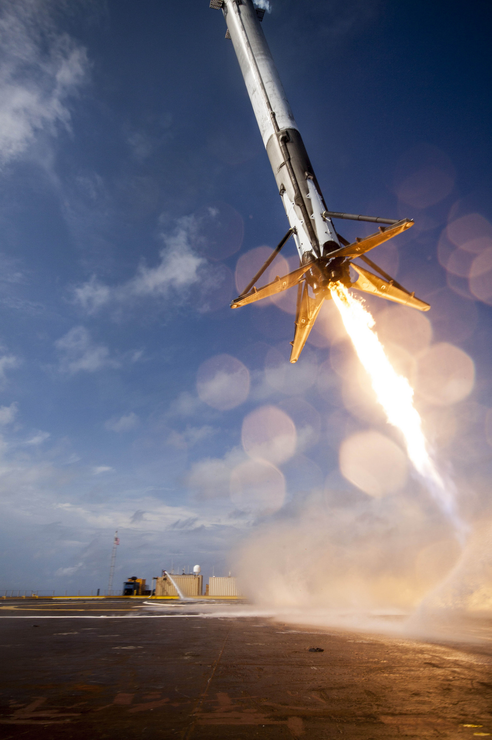
Introduction
Background and Context
The commercial space age is here, with companies making space travel affordable for everyone. One notable company, SpaceX, has achieved significant milestones, including sending spacecraft to the International Space Station, providing satellite internet, and conducting manned missions to space. The company advertises Falcon 9 rocket launches on its website with a cost of 62 million dollars; other providers cost upwards of 165 million dollars each, much of the savings is because it reuse the first stage. Therefore, if we can determine if the first stage will land, we can determine the cost of a launch. We are going to predict if SpaceX will reuse the first stage, based on publicly available information and machine learning.
Question to be answered
How do variables such as payload mass, launch site, number of flights, and orbits affect the success of the first stage landing?
How does the rate of successful landings increase over the years?
What is the best machine learning that can be used for this case (binary classification)?

Slide 5

Section 1

Slide 6
Methodology
Data collection methodology:
Using SpaceX Rest API
Using Publicly available data from Wikipedia (Webscrapped)
Perform data wrangling
Filtering the necessary data
Impute missing data
Perform exploratory data analysis (EDA) using visualization and SQL
Perform interactive visual analytics using Folium and Plotly Dash
Perform predictive analysis using classification models
One-Hot-Encoding and standardize the data
Split the data to train-test with 80:20 ratio
Build, tune and test several machine learning with GridSearchCV
Compare the accuracy of the machine learning on train and test set

Slide 7
Data Collection
Data collection process involved a combination of API requests from SpaceX REST API and webscrapping data from SpaceX Wikipedia.
We had to use both of these data collection methods in order to get complete information about the historical launch for downstream analysis
Data obtained from SpaceX API:
FlightNumber, Date, BoosterVersion, PayloadMass, Orbit, LaunchSite, Outcome, Flights, GridFins, Reused, Legs, LandingPad, Block, ReusedCount, Serial, Longitude, Latitude
Data obtained from SpaceX Wikipedia:
Flight No., Launch site, Payload, Payload mass, Orbit, Customer, Launch outcome, Version Booster, Booster landing, Date, Time

Slide 8
Data Collection – SpaceX REST API
Request historical launch data from SpaceX API
Parse the data with .json and convert to dataframe with pd.json_normalize
From the data filter only the necessary column
Standardize format across all column
Call auxiliary function (getBoosterVersion, getLaunchSite, getPayloadData, getCoreData) to further decode the data
Merge all the data to dictionary
Construct the dataframe from dictionary
Filter the BoosterVersion to only include 'Falcon 9' and reset the FlightNumber indexing
Check and impute any missing value (PayloadMass with .mean())
Export to CSV format
Github URL: SpaceX Data Collection API

Slide 9
Data Collection – SpaceX Wikipedia
Request falcon 9 and falcon heavy data from Wikipedia
Create BeautifulSoup object, and parse the html response
Find and extract the Falcon 9 data
Iterate and call extract_column_from_header to get the column name
Create a empty dictionary with key based on extract_column_from_header results
Iterate, standardize and append the data to dictionary
Convert the dictionary to dataframe
Export to CSV format
Github URL: SpaceX Data Collection Data Collection with Web Scraping

Slide 10
Data Wrangling
In the dataset, there are several different cases where the booster did not land successfully. Sometimes a landing was attempted but failed due to an accident; for example, “True Ocean” means the mission outcome was successfully landed to a specific region of the ocean while “False Ocean” means the mission outcome was unsuccessfully landed to a specific region of the ocean. “True RTLS” means the mission outcome was successfully landed to a ground pad “False RTLS” means the mission outcome was unsuccessfully landed to a ground pad. “True ASDS” means the mission outcome was successfully landed on a drone ship “False ASDS” means the mission outcome was unsuccessfully landed on a drone ship.
In this case, we mainly narrow it down to two category that can be used for downstream analytic or machine learning building. We transform it to two “1” mean the booster successfully landed, “0” mean it was unsuccessful.
Perform basic Exploratory Data Analysis (missing values, data types, etc)
Count the number of launches on each site
Count the number and occurrence of each orbit
Count the number and occurrence of mission outcome of the orbits
Create list of unique landing outcomes
Categorize the landing outcomes to 2 general category
Transform the landing outcomes with the 2 general category
In this case, we mainly narrow it down to two category that can be used for downstream analytic or machine learning building. We transform it to two “1” mean the booster successfully landed, “0” mean it was unsuccessful.
Github URL: SpaceX Data Wrangling

Slide 11
EDA with Data Visualization
In this dataset we used 3 type of charts to do visualization:
Scatter Plot
This plot visualizes the relationship between two numerical variables to identify correlations, clusters, and outliers.
FlightNumber vs. PayloadMass, FlightNumber vs. Launch Site, PayloadMass vs. LaunchSite, FlightNumber vs. OrbitType, PayloadMass vs. OrbitType
Bar Chart
This plot compares categorical data (like OrbitType) against a numerical feature (like the mean of SuccessRate) to show differences between groups.
SuccessRate vs. OrbitType
Line Chart
This plot displays trends and continuous changes in data over a chronological period.
Yearly Launch Success Trend
Github URL: EDA with Visualization

Slide 12

EDA with SQL
Performed SQL querying:
Display the names of the unique launch sites in the space mission
Display 5 records where launch sites begin with the string 'CCA'
Display the total payload mass carried by boosters launched by NASA (CRS)
Display average payload mass carried by booster version F9 v1.1
List the date when the first succesful landing outcome in ground pad was acheived.
List the names of the boosters which have success in drone ship and have payload mass greater than 4000 but less than 6000
List the total number of successful and failure mission outcomes
List all the booster_versions that have carried the maximum payload mass, using a subquery with a suitable aggregate function.
List the records which will display the month names, failure landing_outcomes in drone ship ,booster versions, launch_site for the months in year 2015.
Rank the count of landing outcomes (such as Failure (drone ship) or Success (ground pad)) between the date 2010-06-04 and 2017-03-20, in descending order.
Github URL: EDA with SQL (SQLite)

Slide 13
Build an Interactive Map with Folium
Marker of all Launch site:
Added marker with circle and text label to highlight NASA Johnson Space Center on the map.
Added marker with circle and text label to highlight all launch sites on the map.
Marker and cluster of all launch attempt on each sites:
Added marker and cluster all the launch attempt on each site, green marker if the launch attempt successful, red marker if failed.
Display the distances between launch site to its proximities
Calculate the distance and added line and text label to show the distance.
Github URL: Interactive Visual Analytics with Folium

Slide 14
Build a Dashboard with Plotly Dash
Add dropdown selection and pie chart
Add dropdown launch site selection, enable user to include or exclude launch site for visualization
Add pie chart that will show count of all successful launch for all sites
Add callback that will let pie chart filter based on the dropdown selection
Add a slider and scatter plot
Add slider of payload mass with range of (0-10000), enable user to filter the payload mass
Add scatter plot that will show the correlation between payload and launch success
Add callback that will let scatter plot filter based on dropdown selection of launch sites and slider of payload mass.
Github URL: Interactive Dashboard with Plotly Dash

Slide 15

Predictive Analysis (Classification)
Load dataset
Separate the dependent (target or 'Class') variable from the independent variable
Split the data to the Train-Test with 80:20 ratio
Standardize the data based on the train set, then transform the train and test set
Create a GridSearchCV with cv=10 to find the best parameters
Applying GridSearchCV to LogisticRegression, Support Vector Machine, Decision Tree, and K-Nearest Neighbors models
Validate with the test set for each models
Make dataframe of accuracy of train and test set for each models
Compare the accuracy score of each models based on the train and test accuracy
Github URL: SpaceX Machine Learning Prediction

Slide 16
Results
Exploratory data analysis results
Interactive analytics demo in screenshots
Predictive analysis results

Slide 17

Section 2

Slide 18
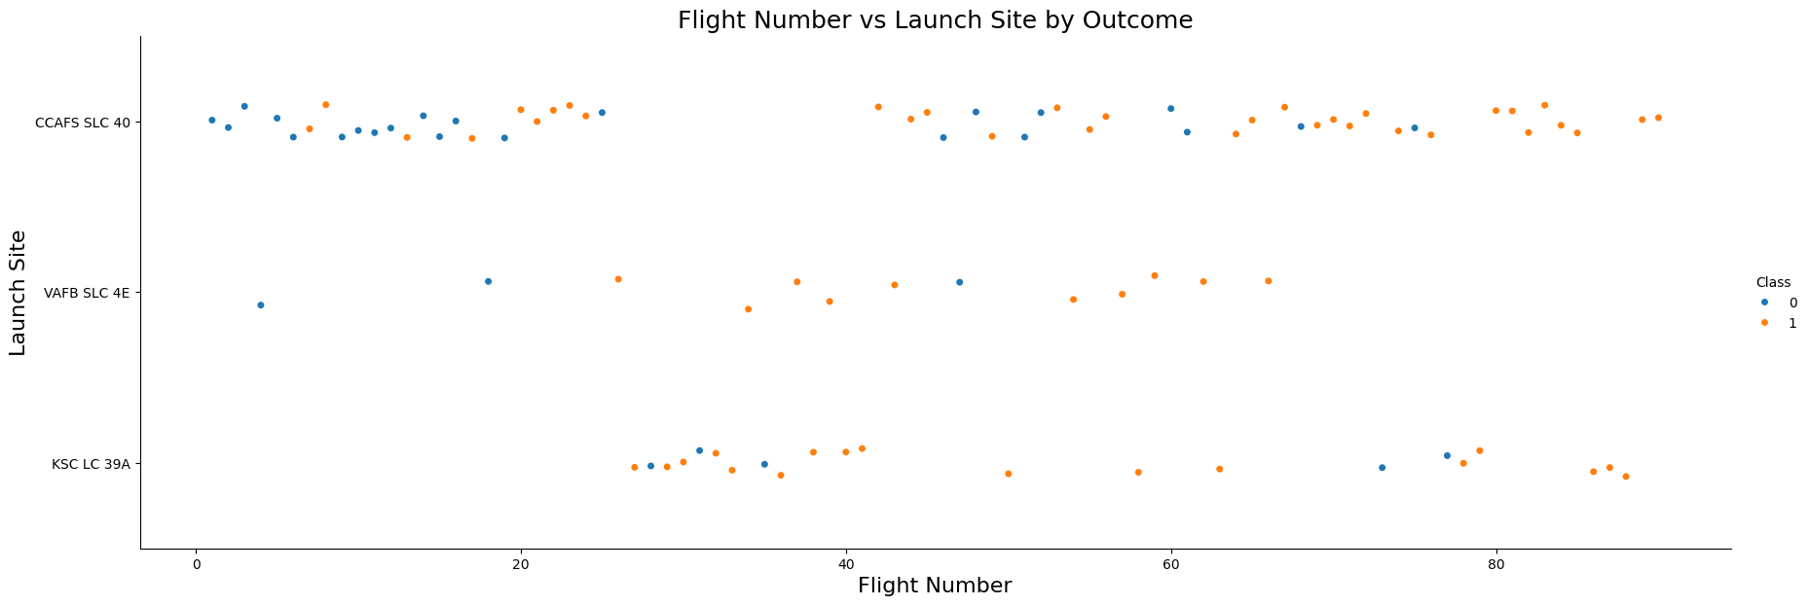
The earliest launch result more on failed, while latest launch result in more success
Most of launch happen in CCAFS SLC-40
VAFB SLC-4E and KSC LC-39A have higher success rate
As FlightNumber increase, we can see that the launch success rate increasing
Flight Number vs. Launch Site

Slide 19
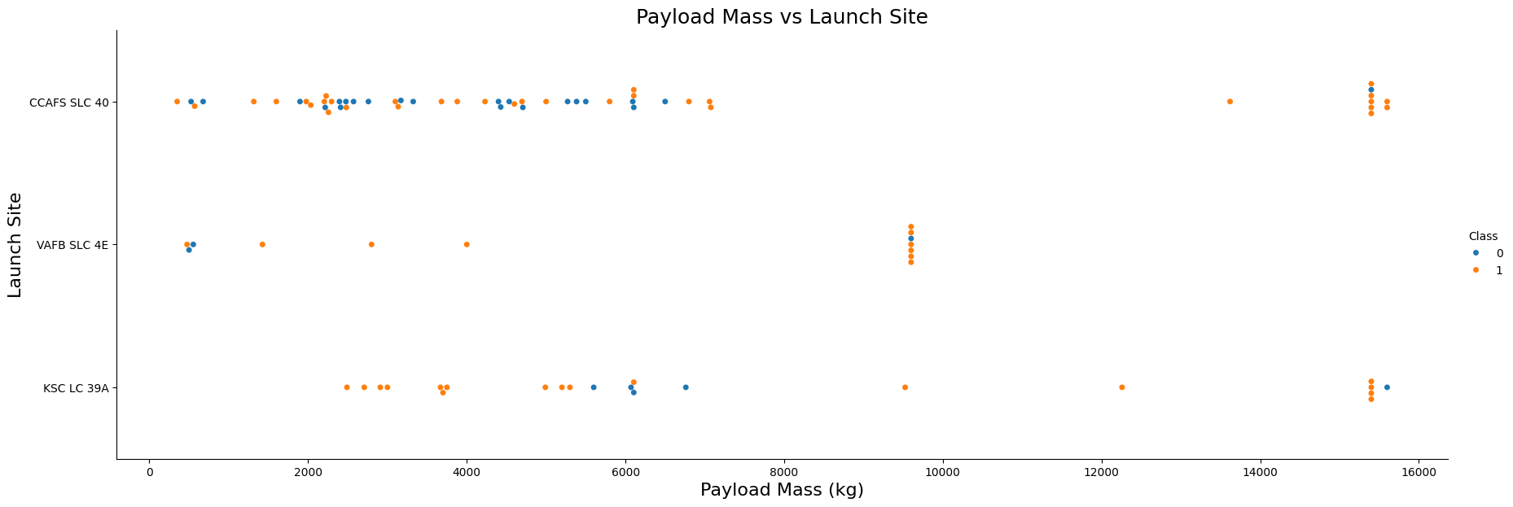
Payload vs. Launch Site
KSC LC-39A and CCAFS SLC-40 have higher chance of success with higher payload mass
VAFB SLC-4E specialized and payload limited to lighter to mid-range payload (generally below 10000 kg)

Slide 20
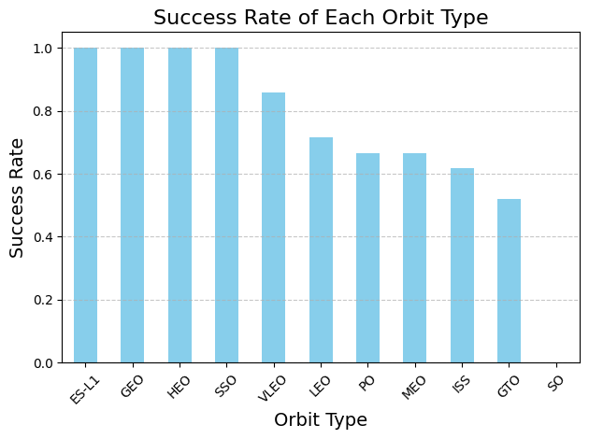
Success Rate vs. Orbit Type
ES-L1, GEO, HEO, and SSO have a 100% success rate
SO have 0% success rate
VLEO, LEO, PO, MEO, ISS, and GTO have 85-50% success rate

Slide 21
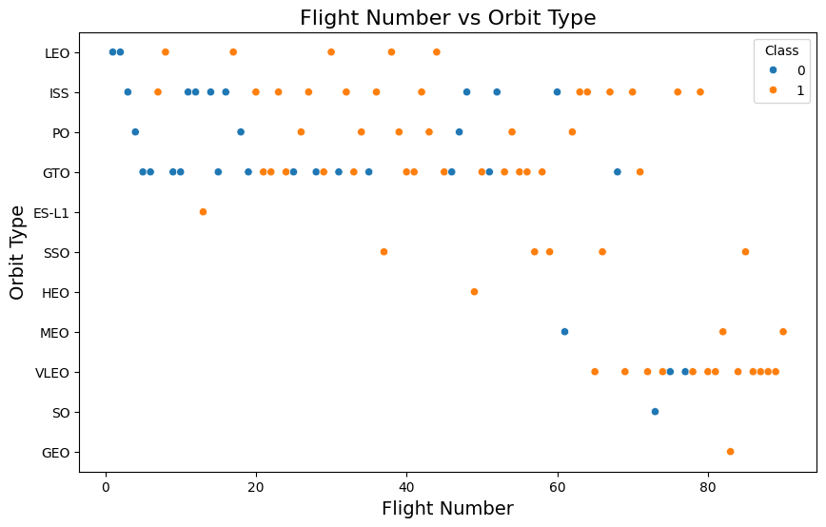
Flight Number vs. Orbit Type
Early flight show a mix of success across multiple orbit types, while later flight have higher chance of success
Most failed occur in LEO, ISS, PO and GTO during early flight, while other orbit have higher chance of success
It can be assumed mission success improves significantly with more flight attempt
Advanced or less frequent orbit types are introduced later and show high success rate

Slide 22
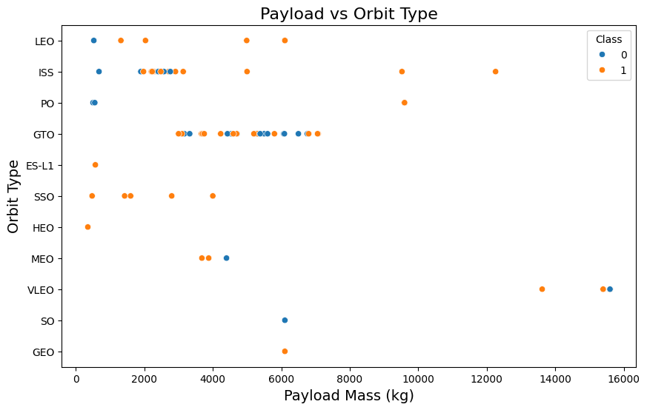
Payload vs. Orbit Type
VLEO has the heaviest payload (13000-16000 kg)
LEO and ISS generally carry light payload (< 7000 kg)
GTO mission cluster around 3000-7000 kg with mix of success and failed
ES-L1, SSO and HEO have 100% success rate

Slide 23
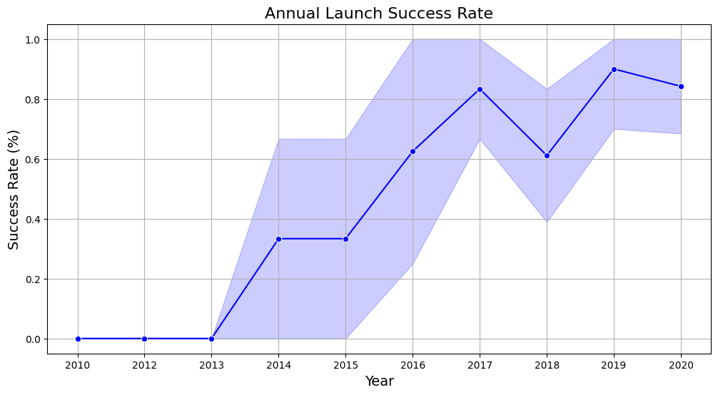
Launch Success Yearly Trend
While early years (2014–2016) showed promise, the data was volatile due to low volume. However, the recent trend (2019–2020) shows both improving performance and increased stability.

Slide 24
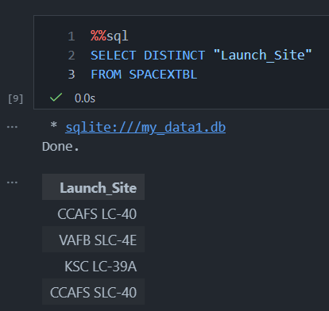
All Launch Site Names
Displaying all unique launch site SpaceX used

Slide 25
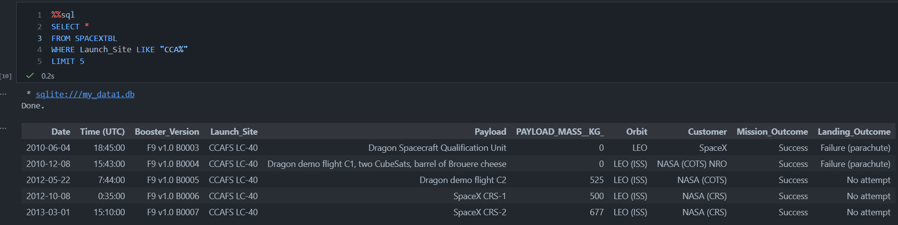
Launch Site Names Begin with 'CCA'
Displaying all record of launch that happen in launch site that has name start with ‘CCA’

Slide 26
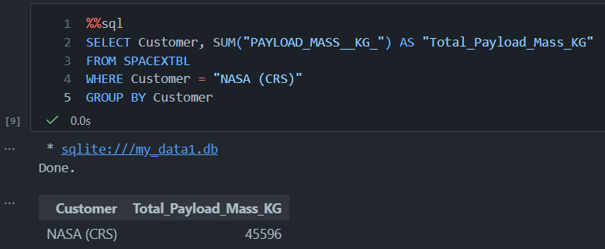
Total Payload Mass
Display the Total Payload Mass has been launched by ‘NASA (CRS)’ with SpaceX service

Slide 27
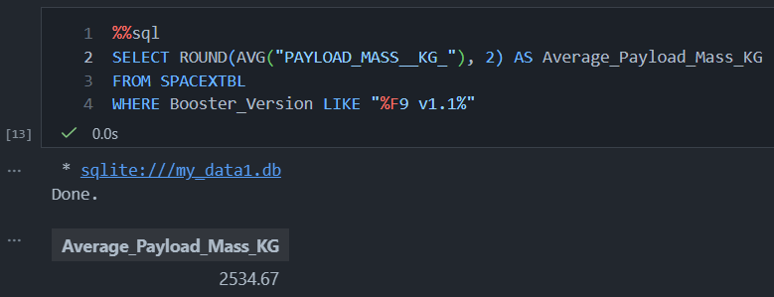
Average Payload Mass by F9 v1.1
Display the average payload mass carried by booster F9 v1.1 and all its derivative variants

Slide 28
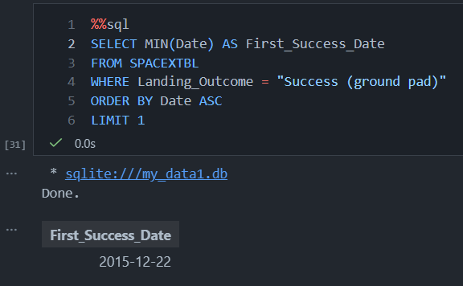
First Successful Ground Landing Date
Display the date of the first successful ground landing achieved

Slide 29
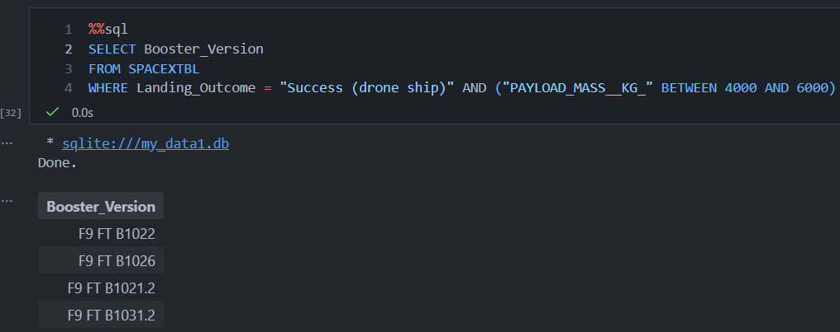
Successful Drone Ship Landing with Payload between 4000 and 6000
Display the booster name that successfully landed in drone ship with payload mass greater than 4000 but less than 6000

Slide 30
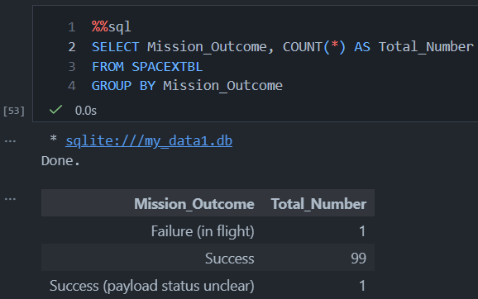
Total Number of Successful and Failure Mission Outcomes
Display the number of successful and failure mission outcomes

Slide 31
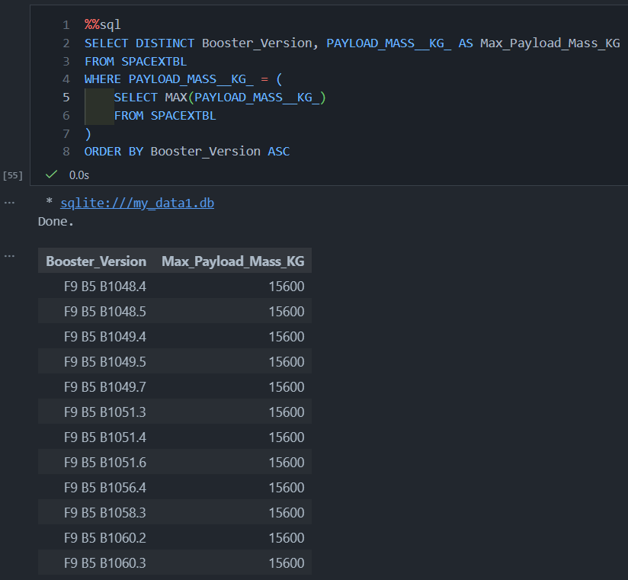
Boosters Carried Maximum Payload
List the names of the booster which have carried the maximum payload mass

Slide 32
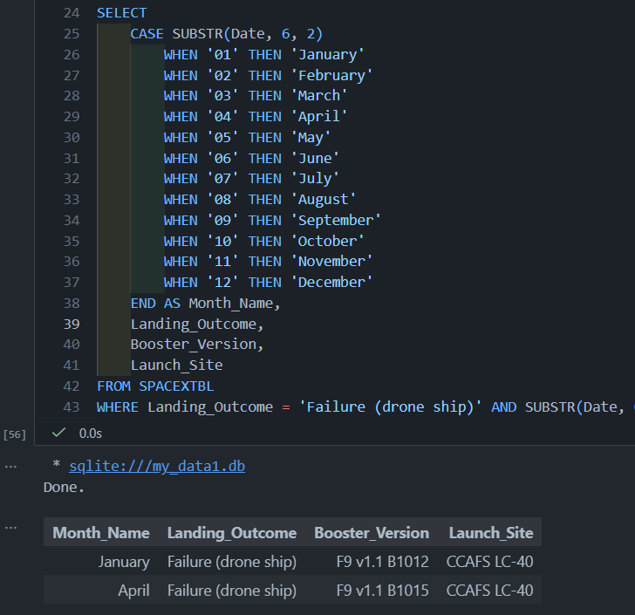
2015 Launch Records
Display the failed landing attempt that happen in drone ship in year = 2015

Slide 33
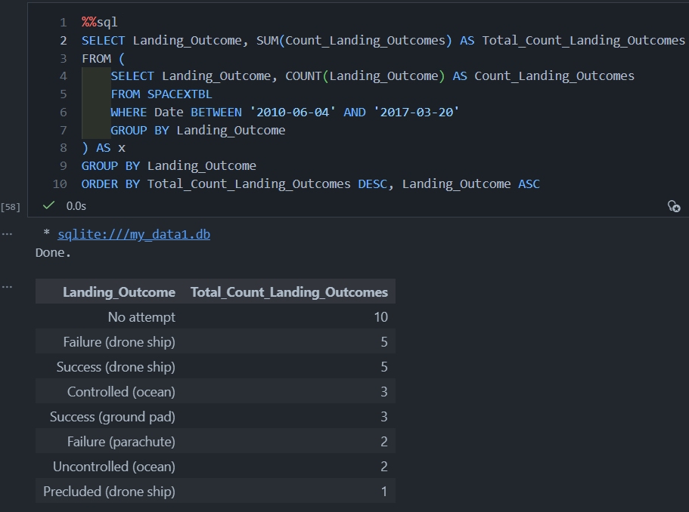
Rank Landing Outcomes Between 2010-06-04 and 2017-03-20
Rank the Landing Outcomes between 2010-06-04 and 2017-03-20 in descending order

Slide 34

Section 3

Slide 35

All launch site's location markers
Most space launch complexes are strategically located near the equator and large bodies of water to maximize physics and safety. Launching closer to the equator allows rockets to harness the Earth’s maximum rotational speed, acting like a natural 'slingshot' which significantly reduces the fuel required to reach orbit. Furthermore, being adjacent to the ocean provides a vast, unpopulated 'drop zone' where spent rocket stages or malfunctioning vehicles can safely fall without endangering human lives or property.

Slide 36
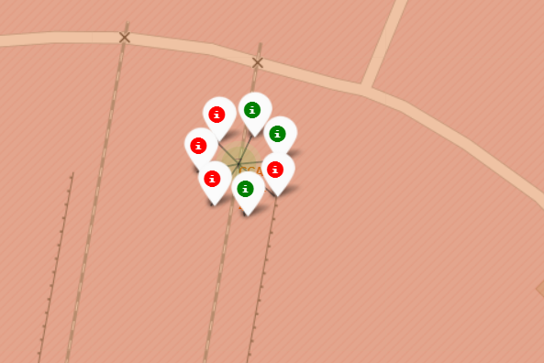
Colour-labeled launch outcome on the map
Added colour labeled marker that will make it easily identify is the launch at launch site successful or failed.
Green colour marker: successful launch
Red colour marker: failed launch
CCAFS SLC-40 have relatively more failed launch

Slide 37
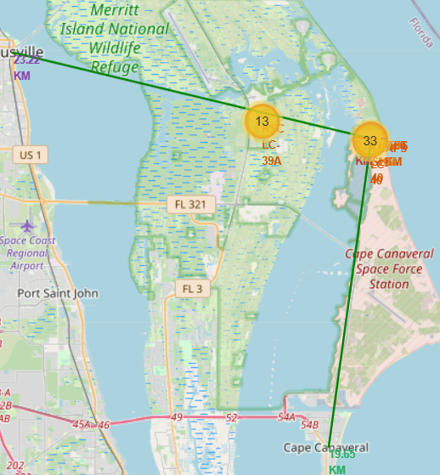
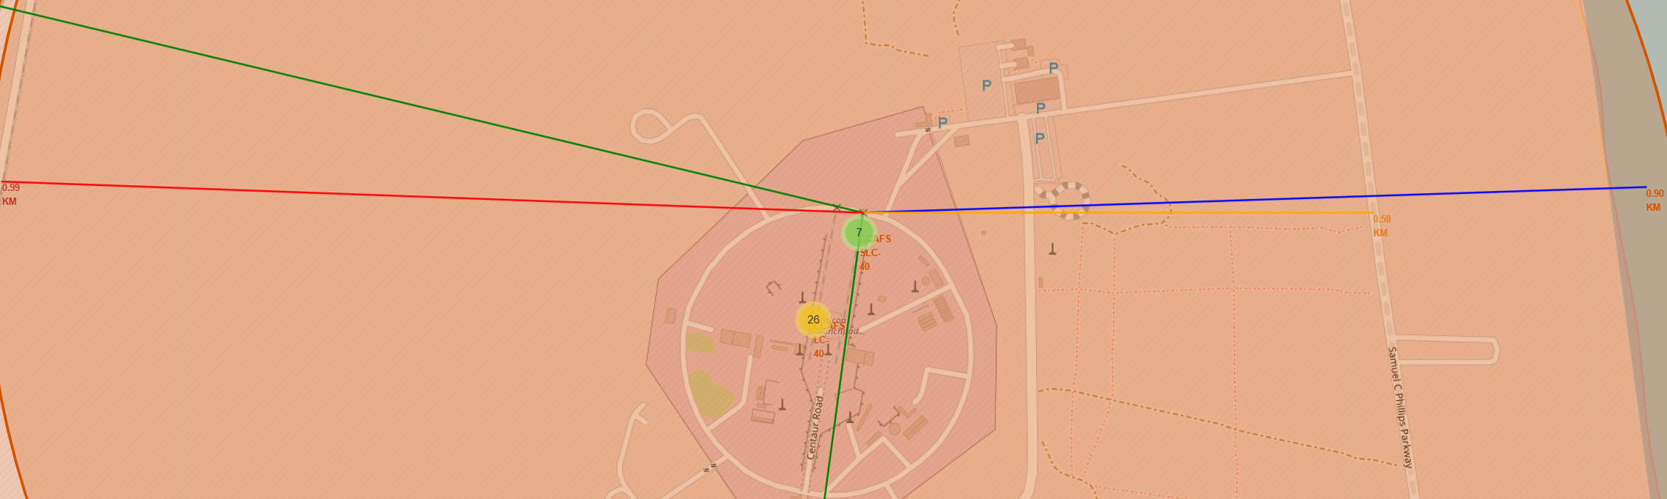
Distance from the launch site CCAFS SLC-40 to its proximities
From the visual, CCAFS SLC-40 we can see that the proximities it is:
launch site to closest coastline (blue line) : 0.89 km
launch site to Cape Canaveral City (green line) : 19.64 km
launch site to Titusville City (green line) : 23.22 km
launch site to closest highway (yellow line) : 0.58 km
launch site to closest railroad (red line) : 28.56 km
Failed or unexpected event that happen during first stage may result in space debris around launch site (15-20km) or another unknown coordinate.

Slide 38

Section 4

Slide 39
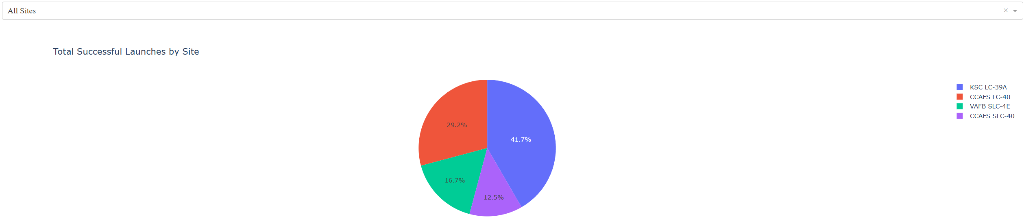
Launch Success for all sites
The chart show all launch success for each site, and from that we can see that KSC LC-39A has the highest successful launch.

Slide 40
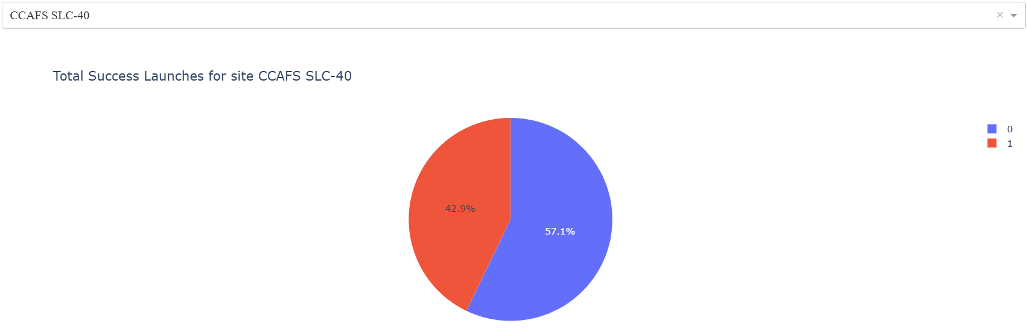
Launch site with the highest launch success ratio
From the chart, CCAFS SLC-40 has the highest launch success ratio, with 3 (Class=1) successful launch and 7 failed (Class=0)

Slide 41
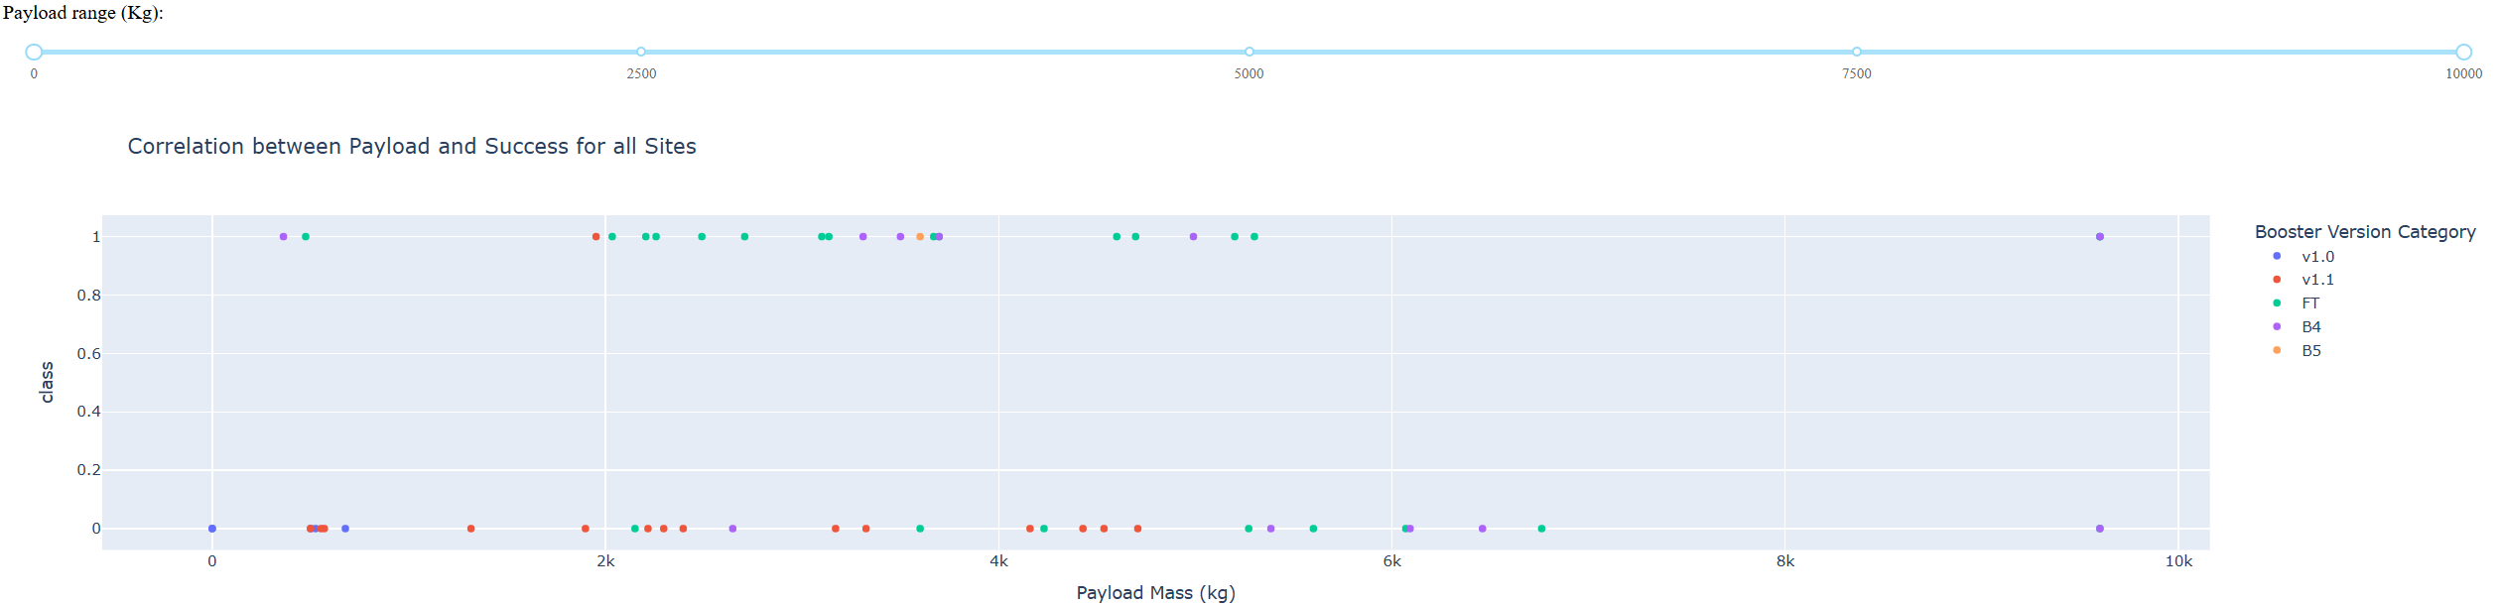
Payload vs. Launch Outcome for all sites
From the chart, we can see most of success launch cluster around payload mass of 1900-3700 kg and 4500-5500 kg

Slide 42

Section 5

Slide 43
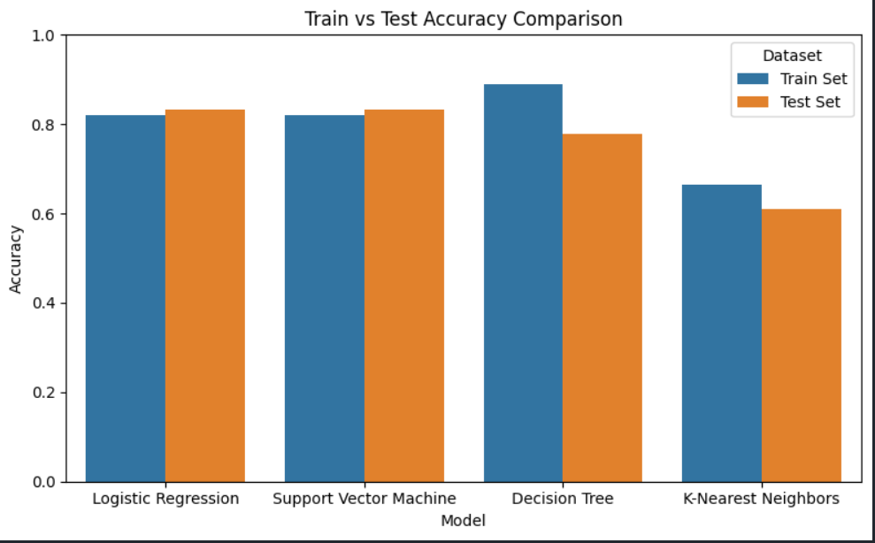
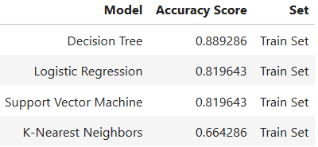
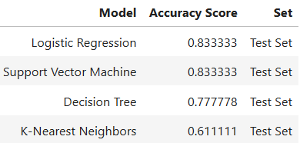
Classification Accuracy
Based on train set, we can see that Decision Tree followed by Logistic Regression and SVM is the best at this classification task
Based on test set both Logistic Regression and SVM is the best at test set with the same accuracy score, but decision tree is falling behind

Slide 44
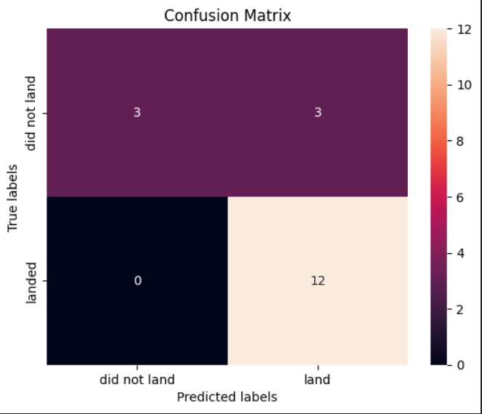

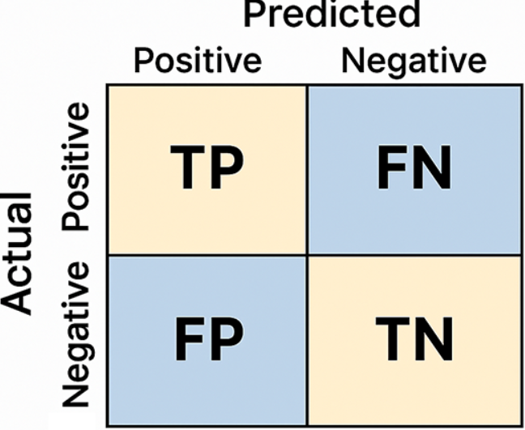
Confusion Matrix
From the previous Bar chart, we know that Logistic Regression and SVM perform well both on train and test set, we also can see that both have the same confusion matrix result, both fall behind on False Negative resulting on error on 3 prediction.
Confusion matrix for SVM on Test Set
Confusion matrix for Logistic Regression on Test Set

Slide 45
Both Logistic Regression and SVM is the best algorithm for this dataset and task.
Most failed occur in LEO, ISS, PO and GTO during early flight, while other orbit have higher chance of success
The success rate of launches increase over year, shows both improving performance and increased stability.
Advanced or less frequent orbit types are introduced later and show high success rate
CCAFS LSC-40 launch site has the highest success rate of launches compare to all the other sites.
Most of launch sites are in proximity to the Equator line and all the sites are in proximity to the coastline
Conclusions

Slide 46
Appendix
Special Thanks to
Instructor
IBM
Coursera

Slide 47


